Slide 1
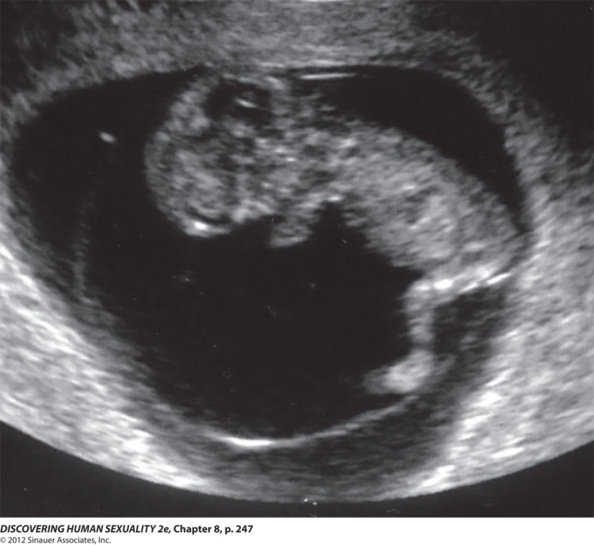
Fertility, Pregnancy, and Childbirth

Slide 2
Chapter 8: Fertility, Pregnancy, and Childbirth
  Pregnancy and Childbirth Raise Major Health Concerns
  Pregnancy Is Confirmed by Hormonal Tests
  Infertility Can Result from a Problem in the Woman or in the Man
  Many Embryos Do Not Survive
  Pregnancy Is Conventionally Divided into Three Trimesters
  The First Trimester Is a Period of Major Changes

Slide 3
Chapter 8: Fertility, Pregnancy, and Childbirth
  The Second Trimester Is the Easiest
  The Third Trimester Is a Time of Preparation
  Labor Has Three Stages
  The Period after Birth Places Many Demands on Parents
  Breast-Feeding Is the Preferred Method of Nourishing the Infant

Slide 4
Pregnancy and Childbirth Raise Major Health Concerns
Before modern medicine, millions of women and children died in or soon after childbirth.
Today:
  Once a child is born, it has a better than 99% chance of surviving through infancy
  Fewer than 2 in 10,000 pregnancies lead to the death of the mother.

Slide 5
Pregnancy Is Confirmed by Hormonal Tests
Fertilization takes place in an oviduct.
After implanting into the endometrium, embryos begin to secrete human chorionic gonadotropin—the hormone that is detected by pregnancy tests.
Blood tests for pregnancy are very accurate and can detect a pregnancy almost immediately after implantation.
  Ordered by a healthcare professional

Slide 6
Pregnancy Is Confirmed by Hormonal Tests
Home pregnancy tests are convenient and popular.
  Results are less accurate
  Retesting is recommended
Definitive clinical evidence of pregnancy can be obtained at 5–6 weeks by an ultrasound scan.

Slide 7
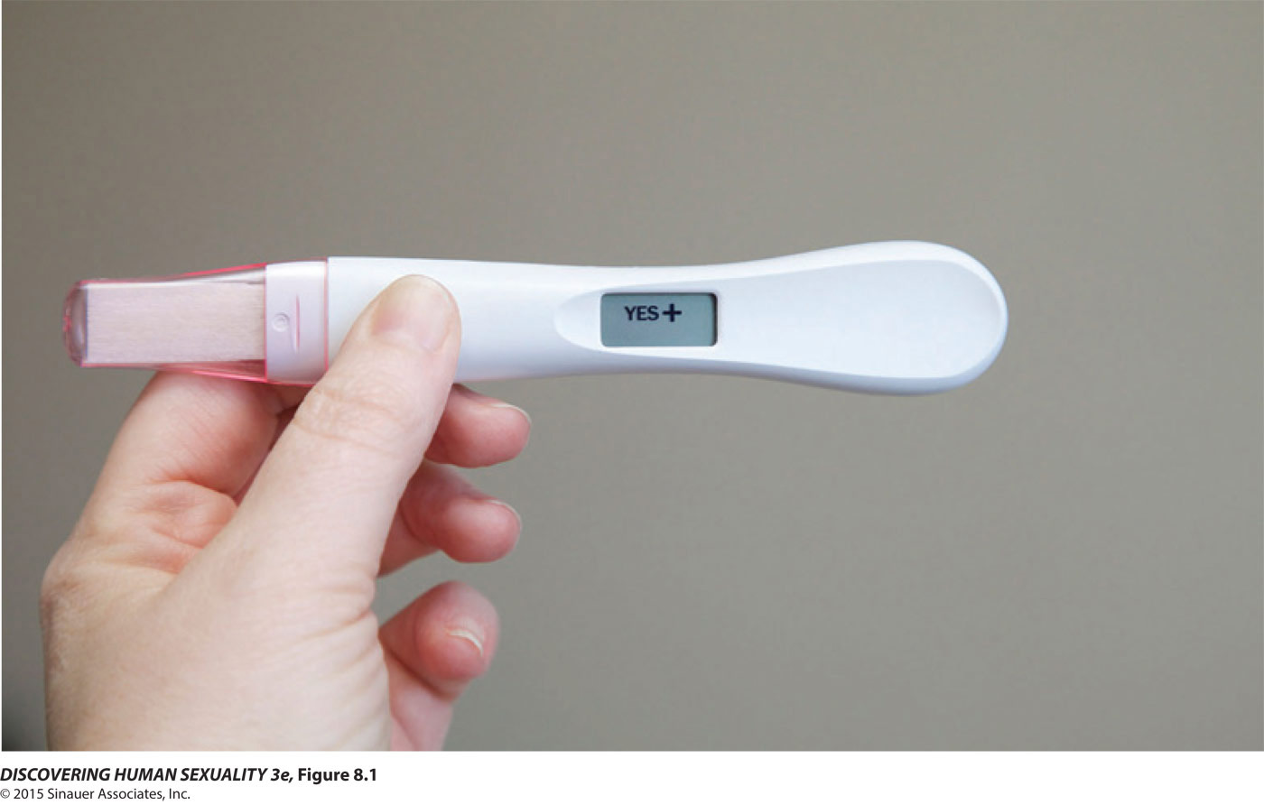
Figure 8.1 Home pregnancy test

Slide 8
Infertility Can Result from a Problem in the Woman or in the Man
Subfertility and infertility are common; approximately 12% of couples seek medical help in establishing a pregnancy.
  Fertility problems may be caused by male factors, female factors, or a combination of the two—in one-third of cases, the problem is on both sides or a cause cannot be identified.
  Fertility declines with age in both men and women.

Slide 9
Infertility Can Result from a Problem in the Woman or in the Man
Insufficient or poor-quality sperm is a common cause of subfertility.
  Undescended testicles
  Sex chromosome anomalies
  Blockages in reproductive tract
  Chemotherapy
  Heating of testes
  Sedentary lifestyle
  Environmental toxins

Slide 10
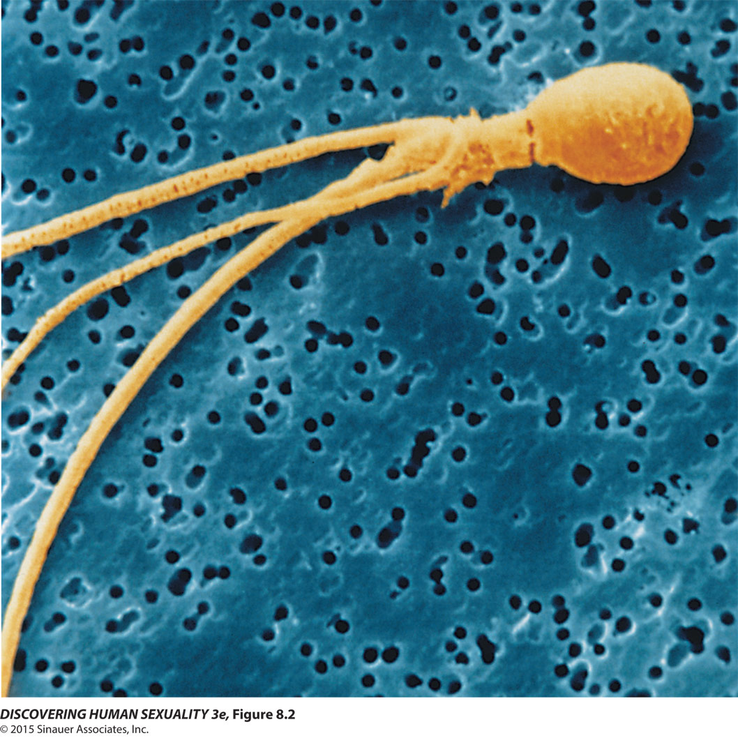
Figure 8.2 Abnormal (multi-tailed) sperm

Slide 11
Infertility Can Result from Problems in the Man or in the Woman
Methods of fertility treatment and assisted reproduction include:
  In vitro fertilization
  Gamete donation (either sperm or oocytes)
  Administration of drugs to stimulate ovulation
  Use of a surrogate mother to carry a pregnancy

Slide 12
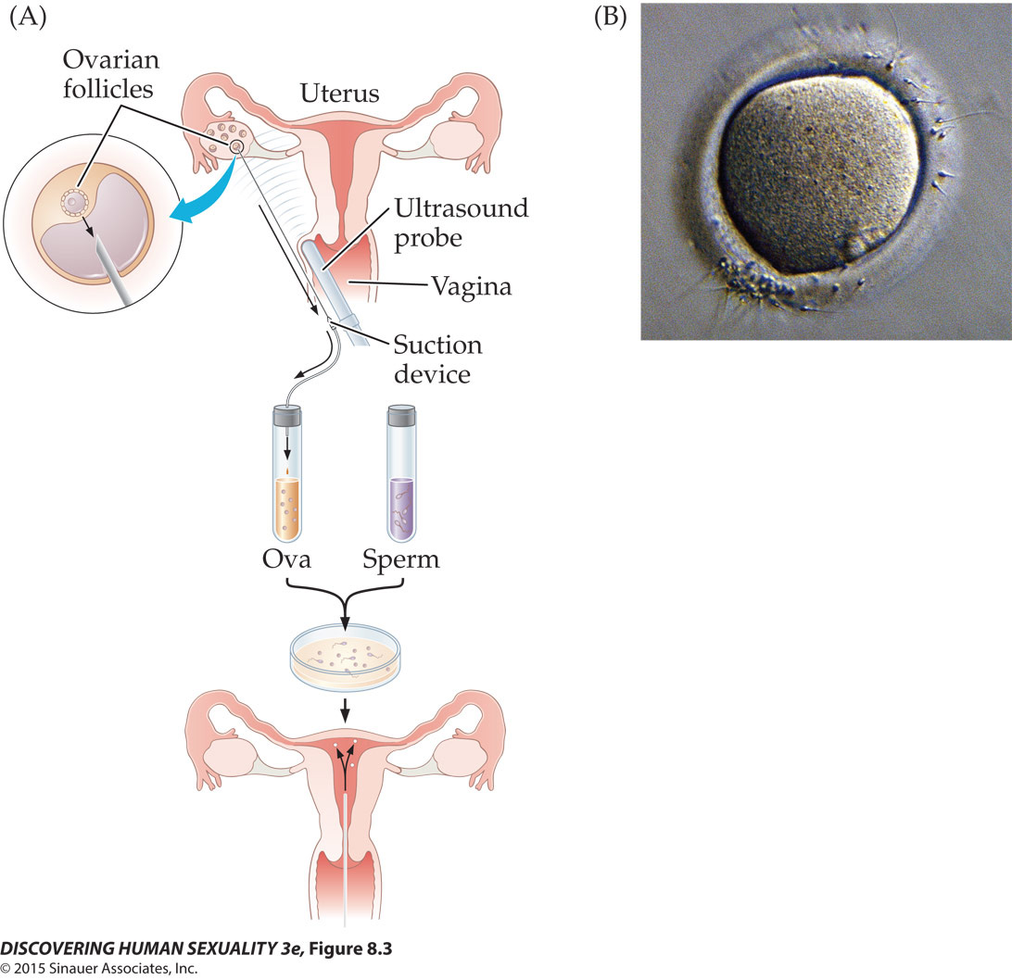
Figure 8.3 Standard in vitro fertilization

Slide 13
Infertility Can Result from a Problem in the Woman or in the Man
In women, subfertility and infertility result from
  Abnormalities of the reproductive tract
    Oviducts that are scarred, blocked, or denuded of cilia
    Uterine fibroids and endometriosis
  Failure to ovulate

Slide 14
Infertility Can Result from Problems in the Man or in the Woman
Adoption is another option for creating families, but the availability of preferred adoptees (healthy infants of a particular race or ethnicity) is limited.
Children born to older parents are more likely to have Down syndrome, physical malformations, mental conditions, or poor academic performance.

Slide 15
Many Embryos Do Not Survive
A large percentage of embryos are genetically abnormal and either fail to implant or are spontaneously aborted (miscarried), usually in the first trimester.
Ectopic pregnancies—implantation at a location other than the uterus—can endanger the mother’s life.

Slide 16
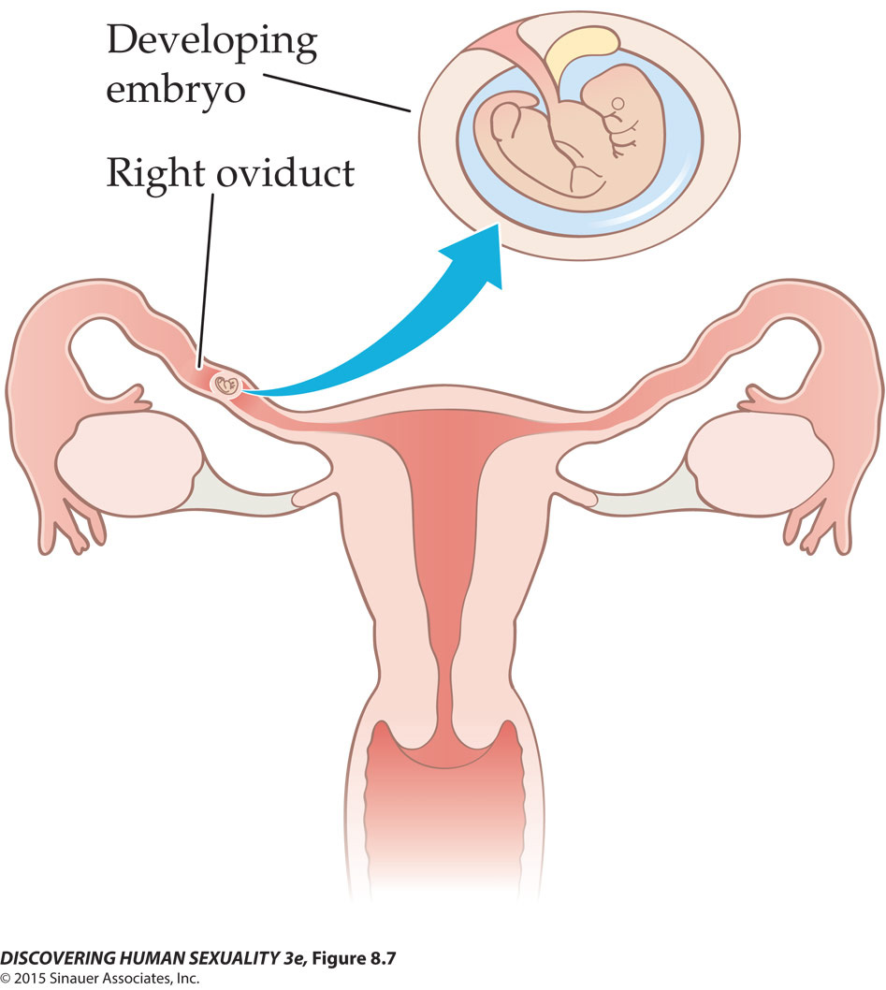
Figure 8.7 Ectopic pregnancy

Slide 17
Pregnancy Is Conventionally Divided into Three Trimesters
A pregnant woman’s due date is usually estimated to be 9 months and 1 week (291 days) after the onset of her last menstrual period, although the true average is 3–8 days longer than this.
Pregnancies should be allowed to continue until at least 39 weeks, unless there is a medical reason to give birth sooner.
Each trimester is about 3 months long.

Slide 18
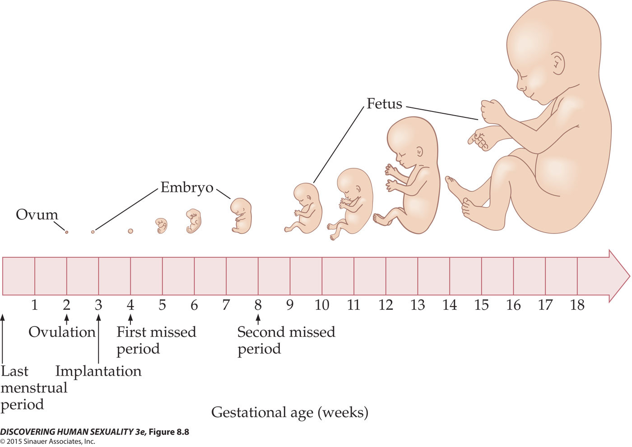
Figure 8.8 Embryonic and fetal growth

Slide 19
The First Trimester Is a Period of Major Changes
During the first trimester, the embryo implants into the uterine wall and establishes a system of hormonal and metabolic communication with the mother through the placenta.
During early pregnancy, women may experience breast tenderness, morning sickness, frequent urination, fatigue, sleeping difficulties, backache, and mood swings.

Slide 20
The First Trimester Is a Period of Major Changes
Prenatal care provides health screenings, education, and support.
Prenatal care decreases the likelihood of maternal, fetal, or neonatal death; fetal prematurity; and low birth weight.

Slide 21
The First Trimester Is a Period of Major Changes
Adequate nutrition is vital to a successful pregnancy.
  The recommended weight gain is 25–35 pounds for a woman with a normal prepregnancy weight.
  Only about a quarter this gain is the weight of the fetus.

Slide 22
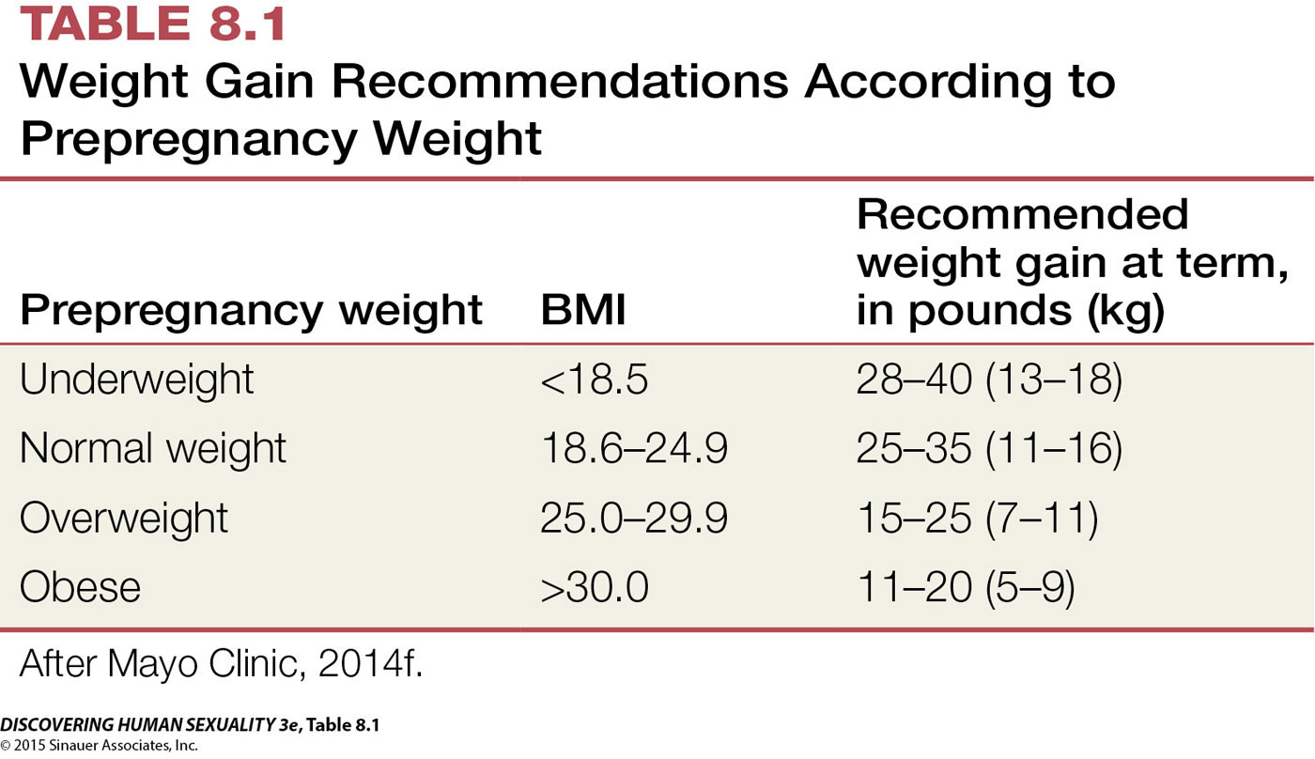
Table 8.1

Slide 23
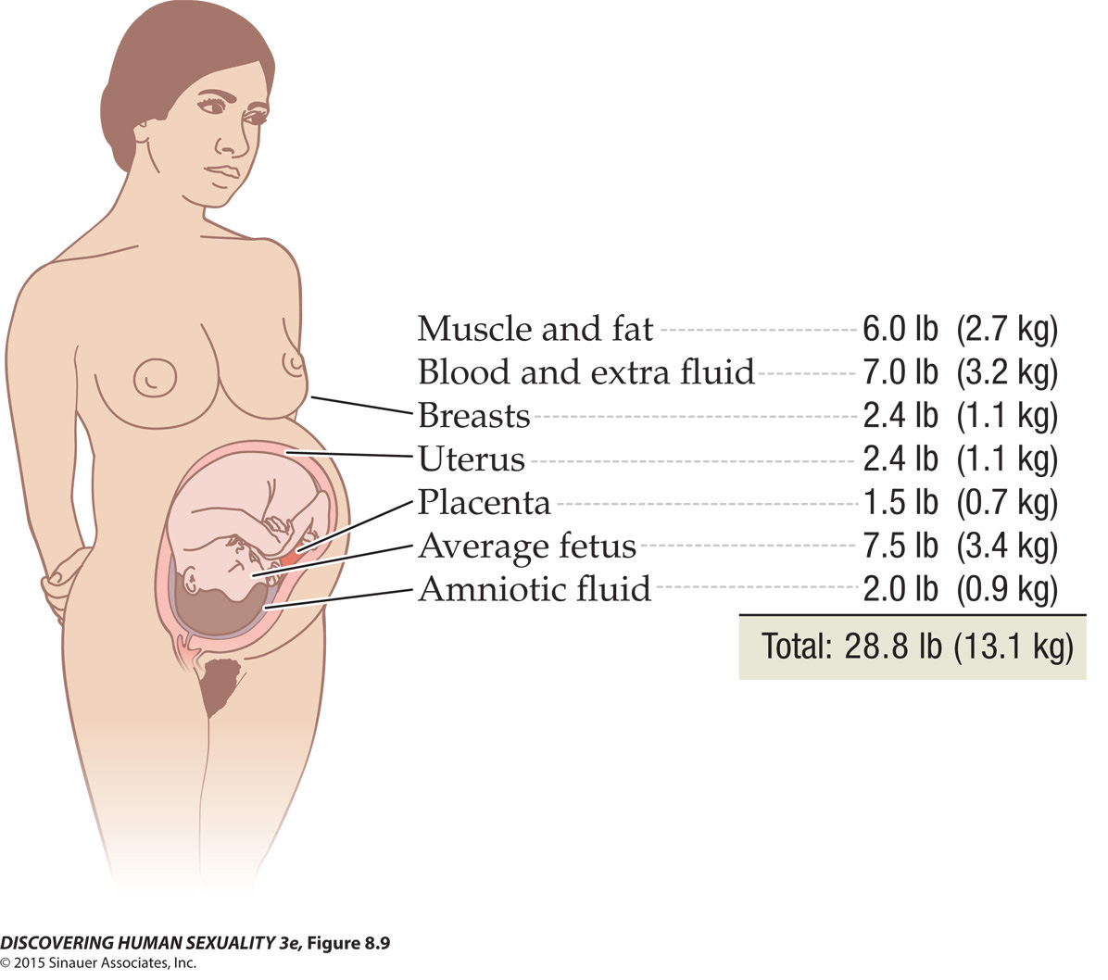
Figure 8.9 Where do those extra pounds go?

Slide 24
The First Trimester Is a Period of Major Changes
Tobacco, alcohol, drugs, infection, and radiation can harm a developing fetus.

Slide 25
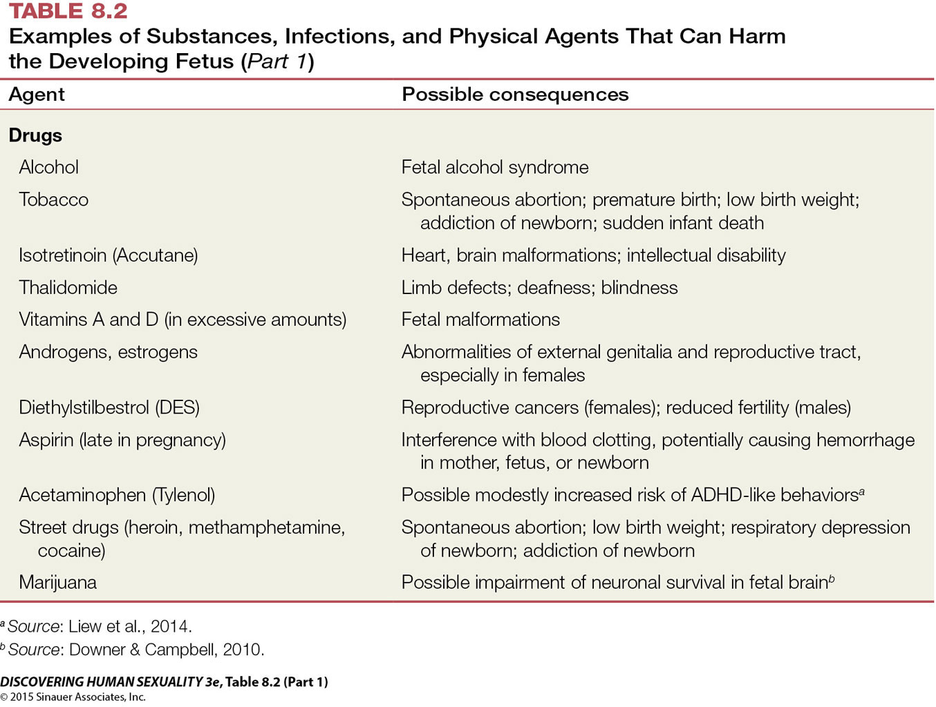
Table 8.2 (Part 1)

Slide 26
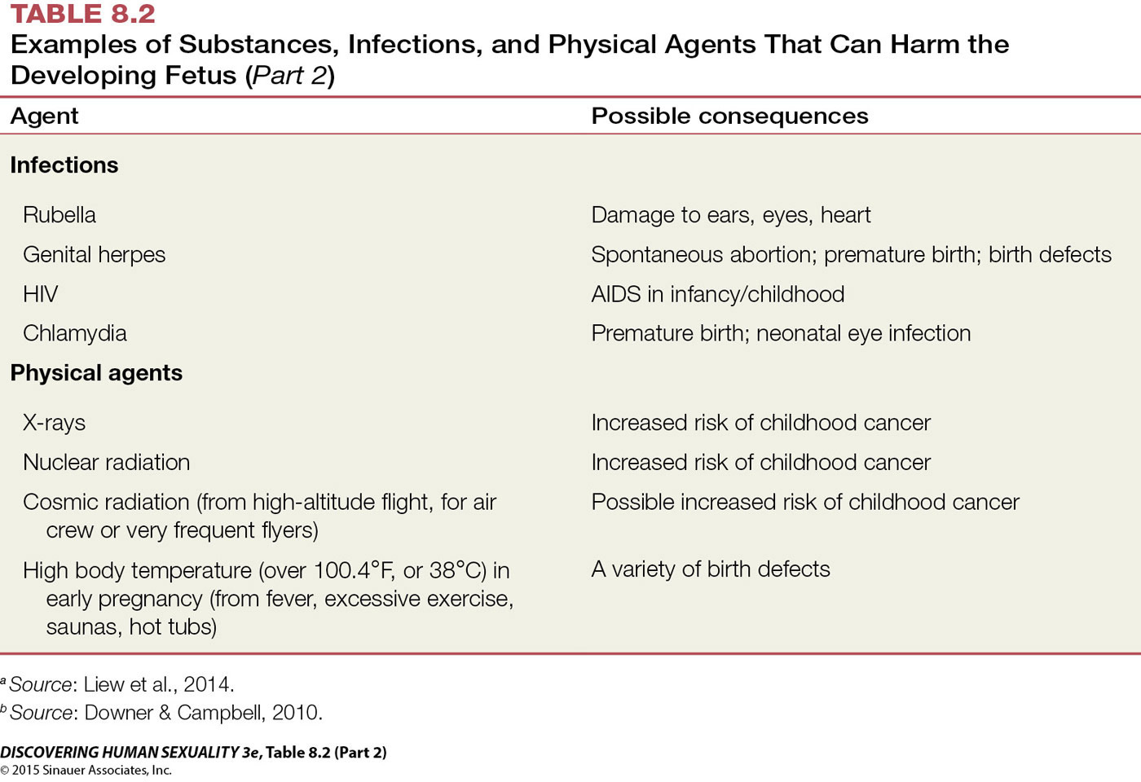
Table 8.2 (Part 2)

Slide 27
The Second Trimester Is the Easiest
The second trimester begins at 13 weeks of gestational age and is usually the easiest trimester for the woman.
Quickening (fetal movements felt by the mother) begins during the second trimester.

Slide 28
The Second Trimester Is the Easiest
Ultrasound scans, amniocentesis, and chorionic villus sampling can be performed to monitor the wellbeing of the fetus and test for congenital disorders, such as Down syndrome and spina bifida.
Except in the presence of certain medical conditions, sex during pregnancy is healthy.
Moderate exercise during pregnancy is beneficial.

Slide 29
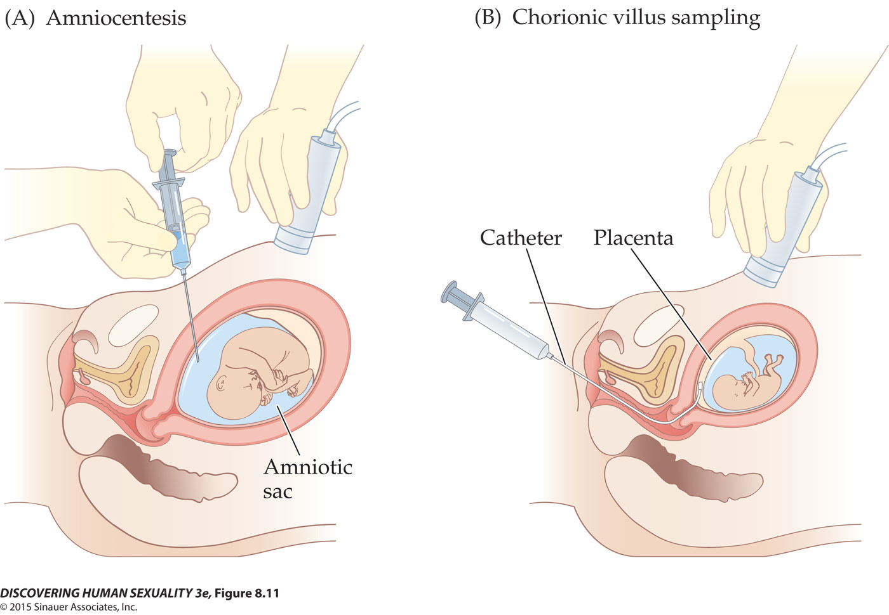
Figure 8.11 Screening for congenital disorders

Slide 30
The Third Trimester Is a Time of Preparation
A child born after the beginning of the third trimester has good chance of surviving if born prematurely, although both premature and delayed births are hazardous.
Women may choose to deliver at home, in a hospital, or in a birthing center; however, hospitals are the best place for childbirth if complications are expected.

Slide 31
The Third Trimester Is a Time of Preparation
Childbirth classes prepare parents for birth.
  Lamaze method
  Bradley method
  Water birth
  Perineal massage
The fetus also prepares for birth by secreting hormones that help the lungs mature and by moving into a head-down position deep in the pelvis (engagement).

Slide 32
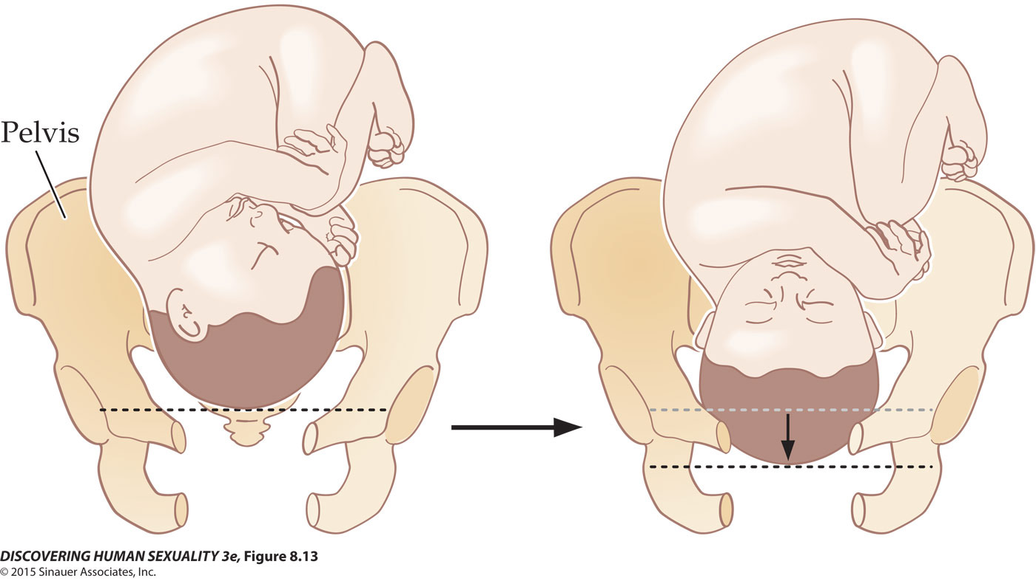
Figure 8.13 Engagement

Slide 33
Labor Has Three Stages
During the first stage, contractions cause the cervix to begin to thin out (effacement) and open up (dilation).
This stage can last from a couple of hours to more than 24 hours.
Many women elect to use anesthesia, such as an epidural, to reduce the pain of childbirth.

Slide 34
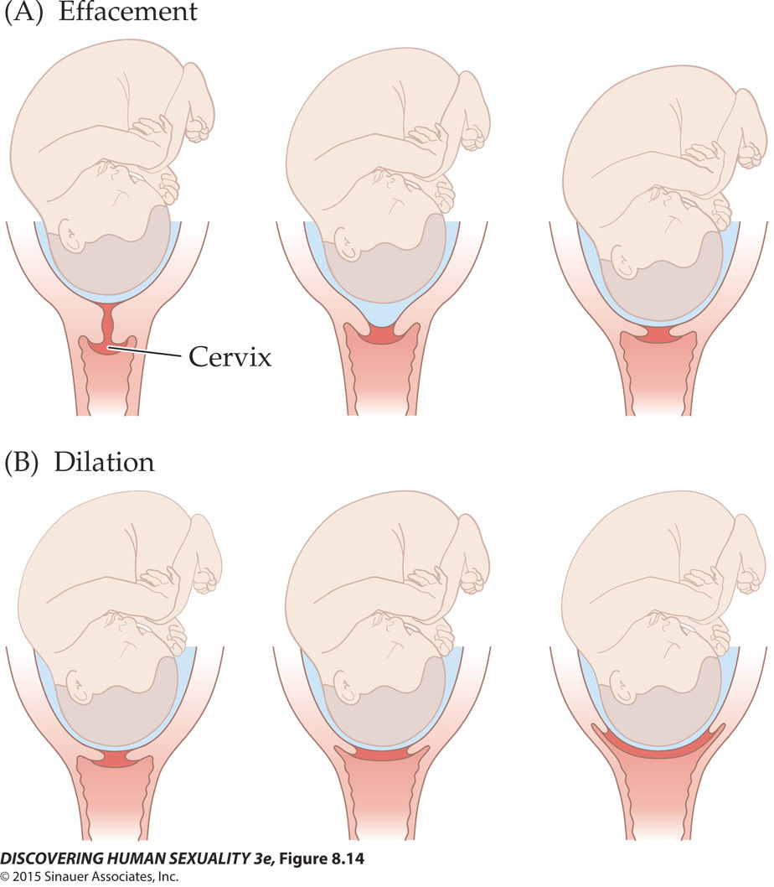
Figure 8.14 Cervical changes during labor

Slide 35
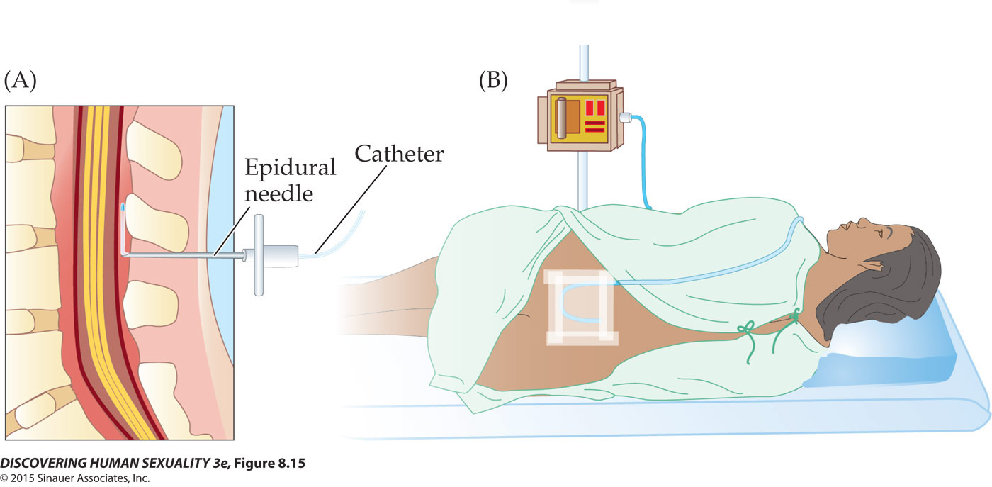
Figure 8.15 Epidural anesthesia

Slide 36
Labor Has Three Stages
The second stage may last a few minutes to several hours and involves passage of the fetus through the birth canal.
Many babies are born via cesarean section, which involves delivering the baby through a surgical incision in the mother’s uterus.
The third stage is delivery of the placenta, or afterbirth.

Slide 37
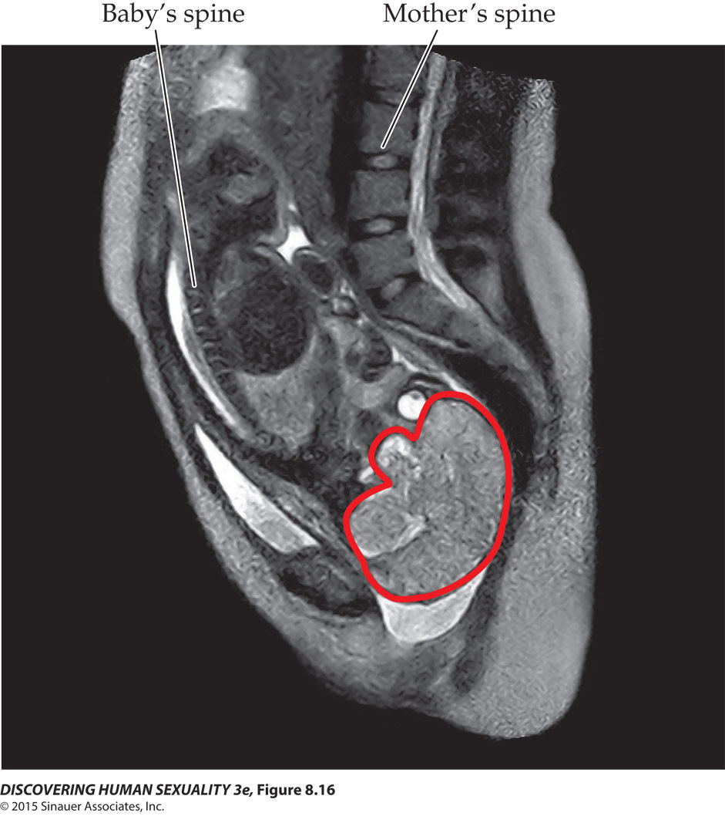
Figure 8.16 A fetus passing through the birth canal

Slide 38
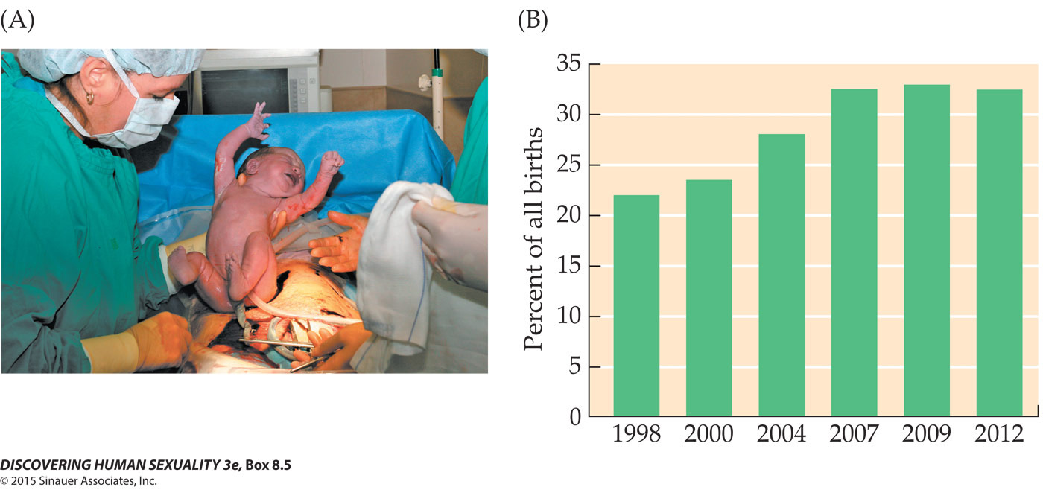
Box 8.5 Sexual Health: Cesarean Section

Slide 39
The Period after Birth Places Many Demands on Parents
Some women experience variable moods after childbirth.
  Postpartum depression is characterized by sustained intense sadness
  Postpartum depression accompanied by disordered thinking is called postpartum depressive psychosis.

Slide 40
The Period after Birth Places Many Demands on Parents
The transition to parenthood often leads to significant changes in a couple’s relationship and sexuality.
  Sexual activity declines
  Marital conflicts increase about ninefold
  Perceived quality of marriage drops
  Partners adopt more stereotypical gender roles

Slide 41
Breast-Feeding Is the Preferred Method of Nourishing the Infant
Lactation is influenced by the hormones prolactin and oxytocin.
For the first few days after birth, the breast milk composition initially supports the infant’s immune system—colostrum.
Over the first two weeks after birth, the milk changes to provide energy and nutrients to promote growth and development.

Slide 42
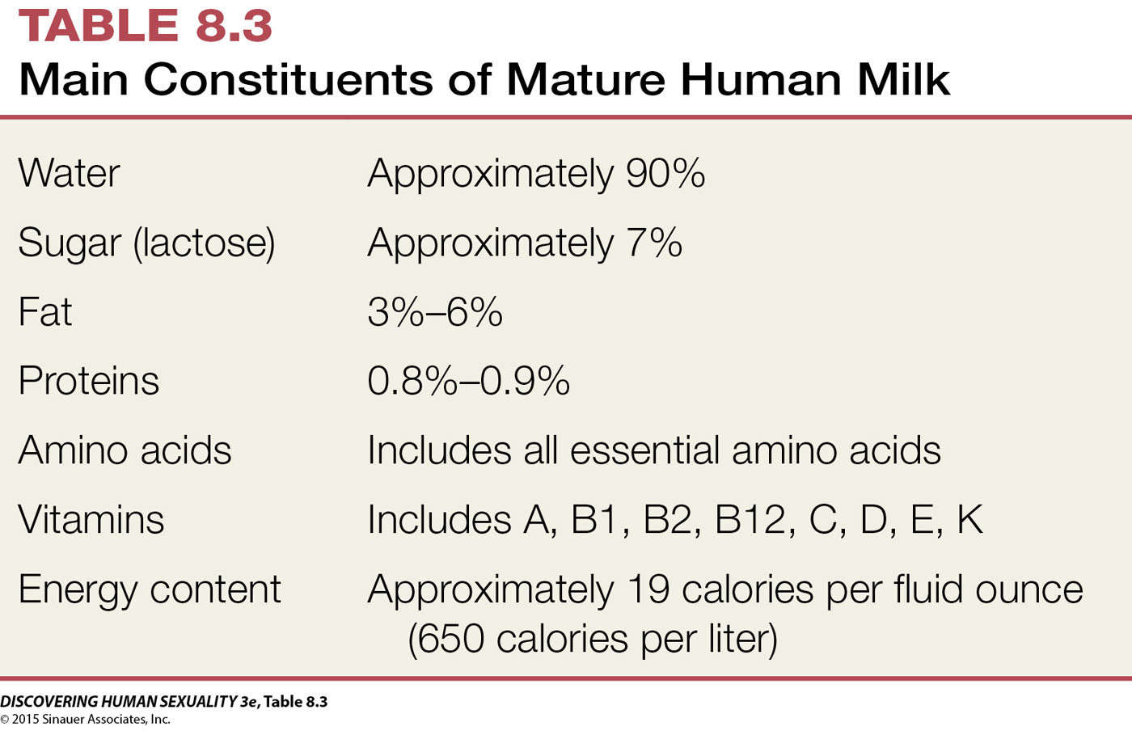
Table 8.3

Slide 43
Breast-Feeding Is the Preferred Method of Nourishing the Infant
Infant formula is an alternative to breast milk and may be used in combination with or as a substitute for breast-feeding.

Slide 44
Breast-Feeding Is the Preferred Method of Nourishing the Infant
Breast-feeding has advantages
  Health benefits for the baby
    Less likely to develop infections
    Less prone to asthma
  Health benefits for the mother
    Helps shrink uterus
    May reduce risk of ovarian and breast cancer

Slide 45
Breast-Feeding Is the Preferred Method of Nourishing the Infant
  Psychological benefits for mother and baby
    Helps establish a close bond
  Convenient and inexpensive
  Contraceptive effect

Slide 46
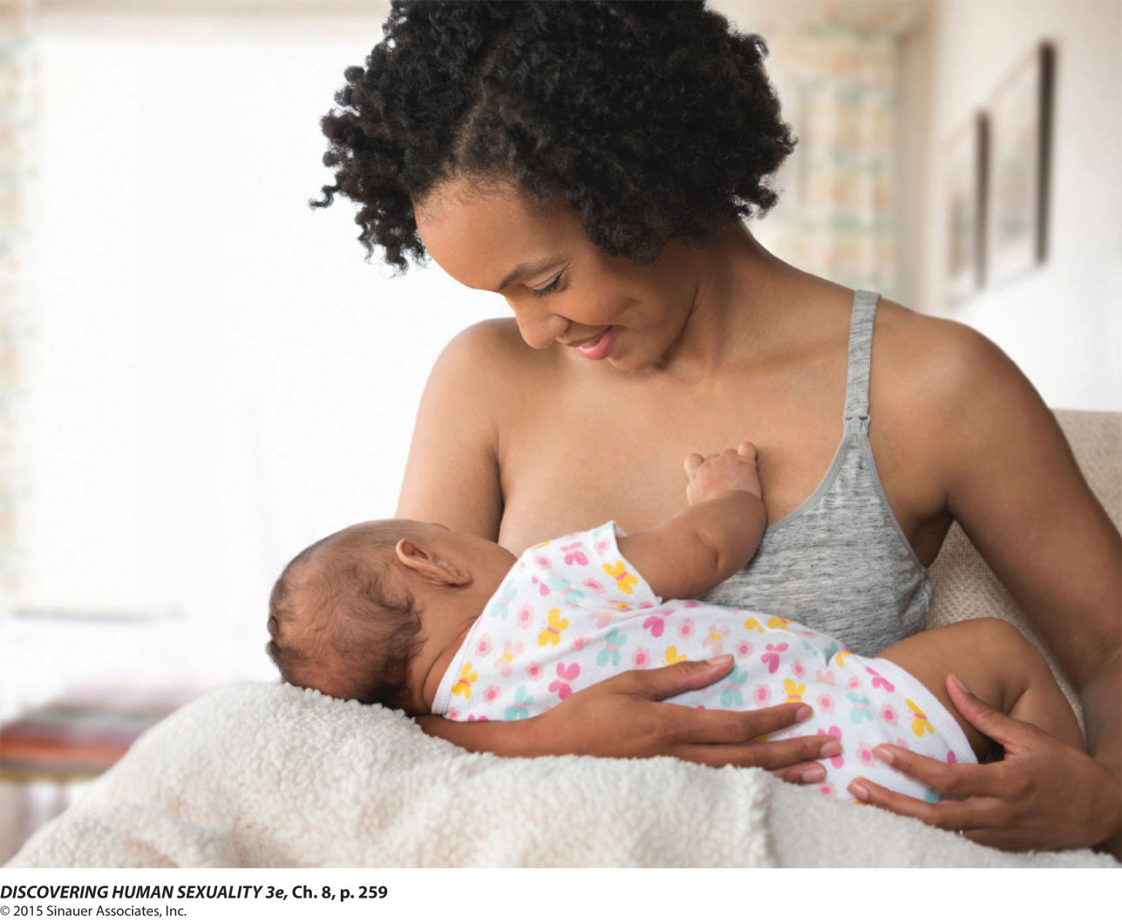
Photo, p. 259 Breast-feeding cements the bond between mother and infant

Slide 47
Breast-Feeding Is the Preferred Method of Nourishing the Infant
Breast-feeding has potential disadvantages
  Painful inflamed nipples or engorgement
  Infection in breasts (20% of women)
  Transmission of viral infections (HIV, hepatitis) and medications from mother to fetus
  Inconvenience, especially for working women.

